Slide 1
DECC’s National Energy Efficiency Data-Framework
RSS Professional Statisticians’ Forum 25 March 2015

Slide 2
Contents
Background
What is NEED?
Developments
Challenges
How NEED has been used
Lessons learnt

Slide 3
Background
Anonymised dataset published and NEED reports awarded National Statistics status.
Results of NEED pilot published.
1948
2003
2004
2009
2011
2012
2013
2014
Individual meter point data first obtained by DTI (now DECC). 2003 & 04 published as experimental statistics, 2005 onwards National Statistics.
First Official Statistics from NEED published.
DUKES first published.
Published new outputs and tools, reviewed methodology and consulted on proposed anonymised dataset.
Energy White Paper – greater regional and local focus required.
Framework for linking data announced in Heat and Energy Saving Strategy (2009).

Slide 4
What is NEED?
Framework for combining data from existing sources
Links data at property level (using UPRN)
Provides insights into how energy is used and the impact of installing energy efficiency measures

Slide 5
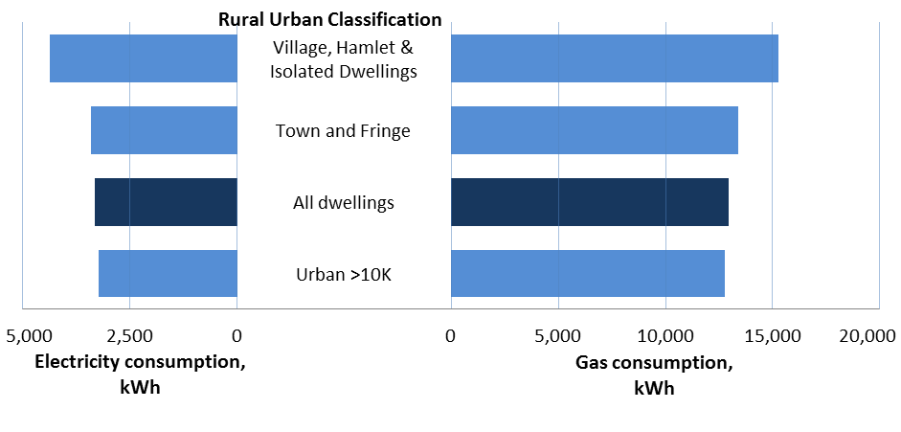
Published reports
Typical consumption by property attributes and household characteristics
Savings in gas consumption following installation of energy efficiency measures

Slide 6
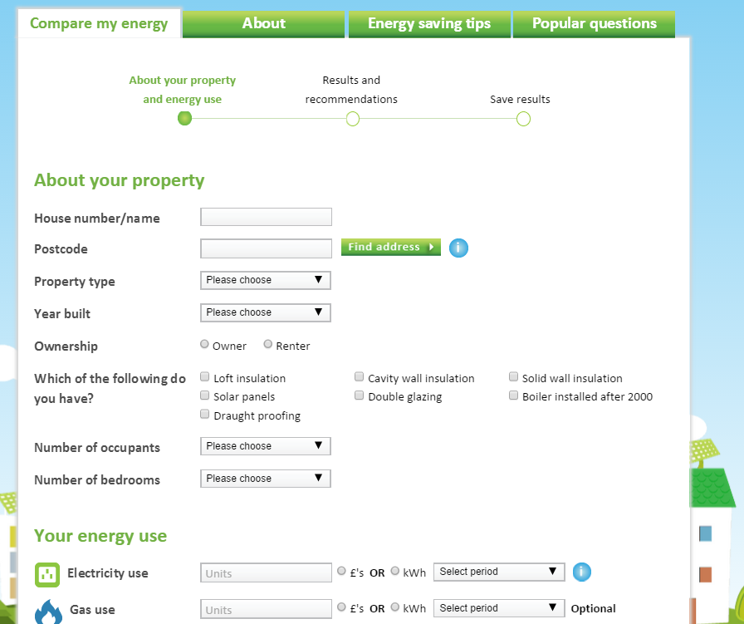

Slide 7

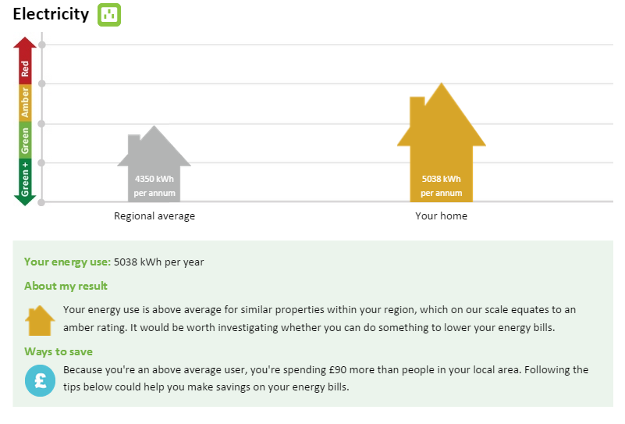

Slide 8
Anonymised dataset
HEED
Energy efficiency measures
Energy Suppliers
EPC
AddressBase
Unique property reference
Consumption (Elec. and gas)
Property attributes
Public use file – approximately 50,000 records available to all.
End user licence file – approximately four million records available via end user licence.
Other
E.g. IMD and FP at LSOA

Slide 9
Future plans
More on interaction of household policies
Inclusion of new data sources (e.g. FITs, Smart Meter flag)
Coverage of Scotland
Development of non-domestic NEED
Models of gas/electricity consumption
Enable wider access to more detailed data in a restricted environment
Understanding uncertainty

Slide 10
Challenges of matching/linking in Government and beyond…
Legal restrictions and access to data
Flexibility
Timeliness
Quality of match/unmatched records
IT infrastructure
Missing data/quality of data/coverage

Slide 11
Lessons learnt
Allow time to make sure all legal elements in place
Added value if compliment other sources of data (e.g. trials & surveys)
Can be useful to help direct more expensive research
Learn from others – often similar issues in different contexts
Setting up access, matching & cleaning more time consuming than analysis
Presentation & dissemination important to engage users/have policy impact
Plan ahead to ensure required permissions in data sources (e.g. new admin)

Slide 12
Further information
Further information on NEED available at: https://www.gov.uk/government/collections/national-energy-efficiency-data-need-framework
Email: EnergyEfficiency.Stats@decc.gsi.gov.uk

